Slide 1
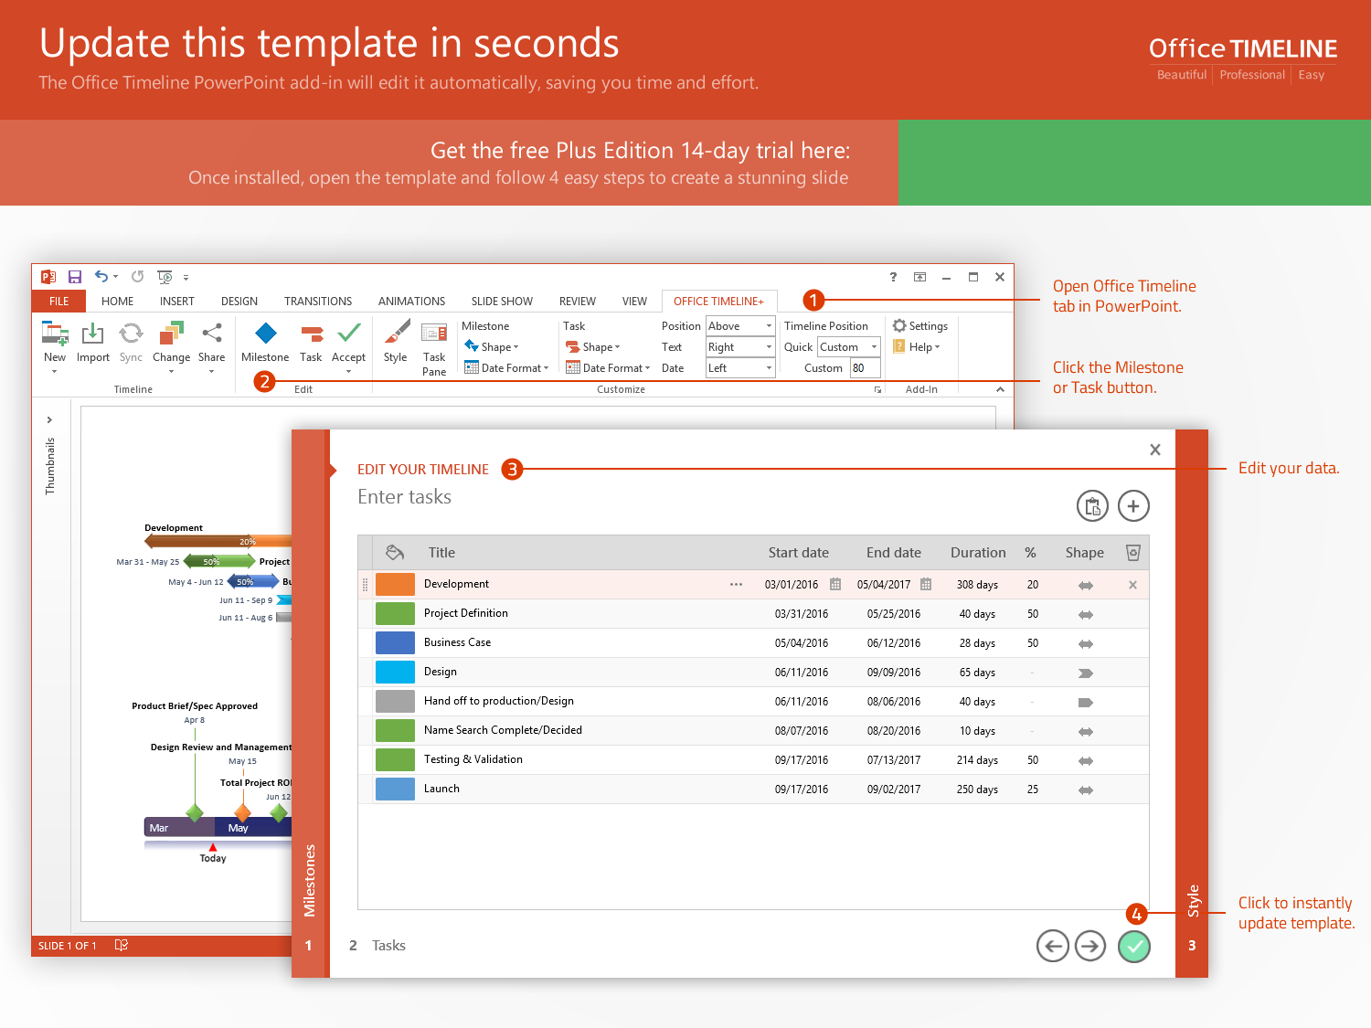
https://www.officetimeline.com/14-days-trial

Slide 2
Project Timeline
Phase 4
Sep 15 - Dec 29
15.2 wks
Phase 3
Apr 15 - Oct 15
26 wks
Phase 2
Mar 1 - May 15
10.8 wks
Phase 1
Jan 1 - Feb 28
8.4 wks
Major Milestone
Major Milestone
Major Milestone
Week 1
5
10
15
20
25
30
35
40
45
Today
Jan 15
Mar 20
May 25
Aug 15
Milestone 1
Milestone 3
Mar 31
Milestone 5
Jun 30
Milestone 7
Sep 30
Dec 28
2017
Feb 20
Apr 25
Jul 15
Milestone 8
2018
Milestone 2
Milestone 4
Milestone 6
Task 1
May 1, 2017
Task 1
May 1, 2017

